Slide 1
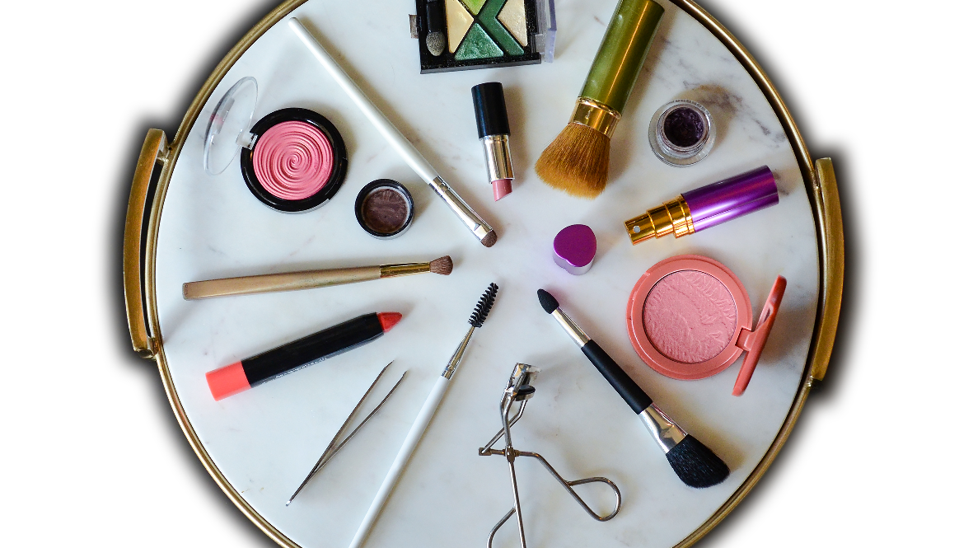
Cosmetics Sales
Ryan Burger

Slide 2
Bends
Overview
Price of cosmetics is affecting the number of purchases made by customers
Problem
Goal
Find out what price points are causing people to not purchase an item
Notes:
Many people are viewing, adding items to their cart and removing it from there cart without purchasing because an item costs to much and this can cost cosmetic companies a lot of money in the long run.

Slide 3
Progressive
Data
Dataset
Kaggle Dataset
eCommerce data - Cosmetics Shop
3.53 million data points
Dataset contents
Time
Event_name
Product_id
Category_id
Category Name
Brand
Price
User_id
Session
Category_1
Category_2
Category_3
Data Selected
Columns
Event_name
Removed_from_cart
Purchase
Price
Removed items with a price of 0 <

Slide 4
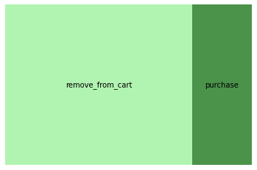
Data Analysis
Highest priced item: 327.78
213,176 items were purchased
664,340 items were removed from the cart

Slide 5
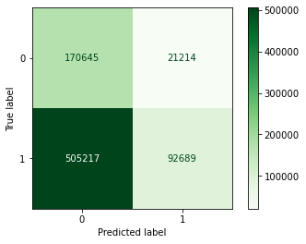
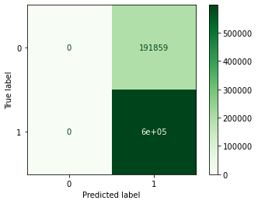
Model Evaluation
XGBOOST
Linear Regression
Accuracy = .867
Matrix:
Accuracy = .7570
Matrix:

Slide 6
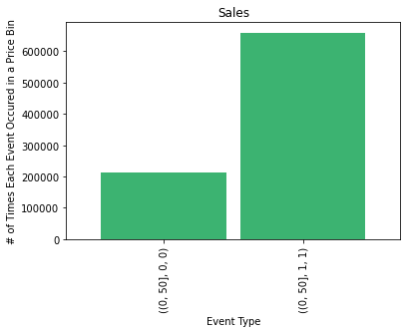
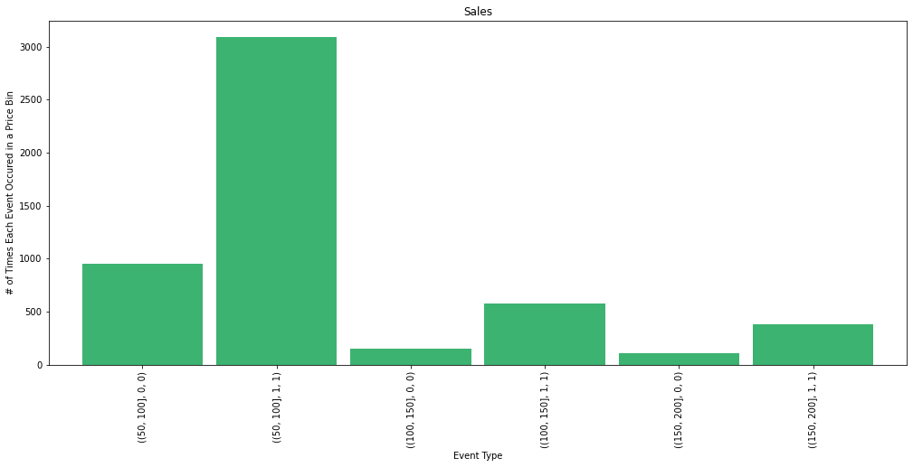
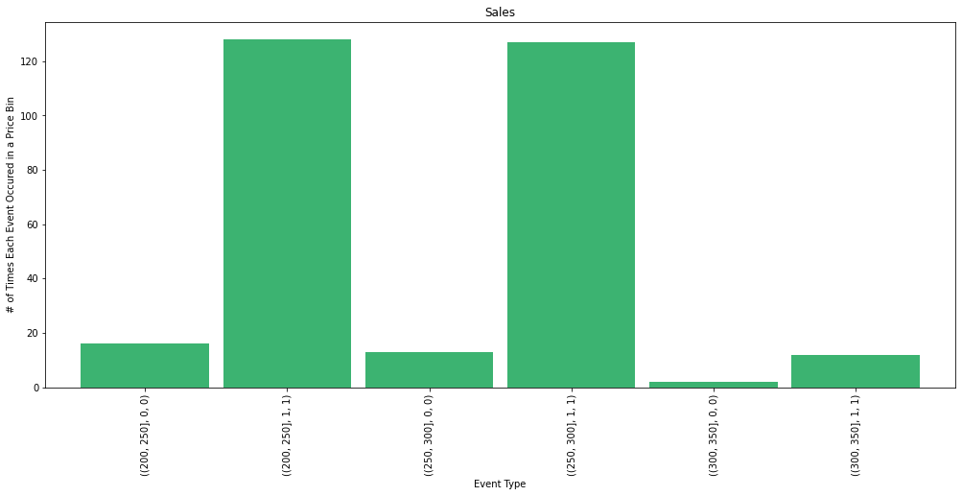
Findings
75.70%
24.30%
76.50%
88.89%
90.72%
23.50%
79.29%
78.06%
20.71%
11.11%
9.28%
85.72%
21.94%
14.28%

Slide 7
Ranking elements
Recommendations
Findings
Don’t sell items above
$200
Next Steps
Have less of the items priced above $200
Look into having a sale on the higher priced items if they are not selling

